Slide 1
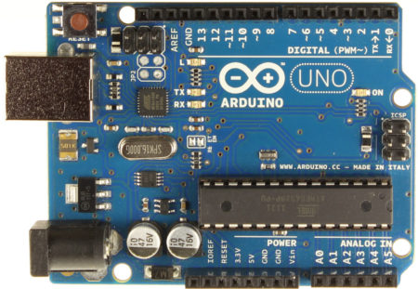
MODULE 9 – CONTROL SYSTEMS: MICROPROCESSOR CONTROL

Slide 2
Goal
This module is to provide an introduction to microprocessor control systems and how they can be used for ROV control. The MATE ROV Control System is used as a reference.

Slide 3
Objectives
Upon completion of this module, the student should be able to:
  Identify the main components of a microprocessor system
  Describe binary signaling levels representative of a binary 0 and binary 1
  Connect the Arduino controller to a laptop and download software
  Use sample programs for basic interfacing

Slide 4
Sections
  Microprocessor Control Systems
    Microprocessors
    Input/Output Devices
    Communication
  The Arduino Uno Board
    EEPROM
    RAM
    Programmable Input/Output pins
    Analog Input pins
    USB connection

Slide 5
References
  “Underwater Robotics Science, Design & Fabrication”, Chapter 9

Slide 6
Objective 1:
Identify the main components of a microprocessor system

Slide 7
Definitions
Input Device:
  An input device provides data and control signals to a computer
  On an ROV, input devices may include:
    Joystick (input from human operator)
    Keyboard (input from a human operator)
    Voltage/current sensors (inputs regarding system health)
    Underwater camera
    Depth sensor
    Heading sensor
    Pitch/roll sensor
    Leak detector
    Temperature sensor
    And many more depending on the application

Slide 8



ROV Input Devices

Slide 9
Definitions (cont’d)
Output Device:
  An output device is used to communicate the results of a process into human observable form.
  On an ROV, output devices may include:
    Video display
    Thruster speed/direction
    Tool actuation
    Lighting control

Slide 10

ROV Output Devices

Slide 11
Definitions (cont’d)
Control System:
  A control system regulates outputs based upon a set of inputs and an established control protocol.
  On an ROV, the control system is comprised of inputs, outputs as indicated above, one or more computers, and of course, one or more human operators

Slide 12
ROV Control System
Computer(s)
Outputs
Human operator(s)
Inputs
Joystick
Camera
Thrusters
Video monitor

Slide 13
Computers in ROVs
Industrial ROVs rely on one or more computers for control
The computers may be either on board the ROV, at the surface, or distributed
Computers may include the desktop or notebook type that we use regularly but will also likely include one or more embedded controllers

Slide 14
Embedded Controller
An Embedded Controller incorporates all of the components of a microprocessor system on a single integrated circuit (chip). These components include:
  Microprocessor
  Memory
  Input/Output
    Pins that receive inputs from other system devices
    Pins that provide outputs to other system devices
Now, consider the function of each of these components

Slide 15
Microprocessor
This is the brain of an embedded controller. It is responsible for:
  Controlling the flow and timing of the computer program
  Performing all arithmetic and logic operations
  Exchanging information with the memory and input/output devices

Slide 16

Memory
Embedded controllers use two types of memory:
  EEPROM (Electrically Erasable Programmable Read Only Memory) is non-volatile memory. That is, the information remains even through a power-down.
  RAM (Random Access Memory) is volatile memory. That is, the information is lost when the controller loses power.

Slide 17
Memory (cont’d)
Note that the main difference between EEPROM and RAM is volatility. If information has to be available next time you power up, such as the program, it must be stored in EEPROM.
Why bother with RAM since we can write to EEPROM?
  It is faster to write to RAM and computers are prized for their speed.

Slide 18
Input/Output
The embedded controller uses dedicated pins to communicate with the input and output devices
The input pins receive signals from the human operator and sensors on the ROV
The output pins send signals to the human operator and control the thrusters and tools on the ROV

Slide 19
Objective 2:
Describe binary signaling levels representative of a binary 0 and binary 1

Slide 20
Information Representation
Reference Chapter 9, section 5.3 – 5.8

Slide 21

Information Representation
Computers represent information as a pattern of 1s and 0s. Computer electronics are only stable in one of two states. Hence, they are binary (bi=two) systems.
Conventionally, a high voltage (usually 5V) is a 1 and a low voltage (usually 0V) is a 0.
Numbers, letters, video, audio, temperature, depth, etc. can be represented in binary format.

Slide 22
Information Communication
Each input/output pin will either be 5V (high or 1) or 0V (low or 0) at any point in time
Data may be exchanged with the outside world in parallel using multiple pins to represent a value.
However, due to the limited number of pins, on an Embedded Controller, data is more likely to be exchanged with the outside world serially by sending a series of 1s and 0s on a single pin.
Communication is only successful when both the sender and receiver agree on the coding protocol in terms of voltages and data rates.

Slide 23

Information Communication (cont’d)
There are many standard data communication protocols including:
  RS-232
  RS-485
  I²C
  Ethernet
  USB
These examples all happen to be serial protocols
An embedded controller can communicate using any of these methods using appropriate interfaces and software

Slide 24
Embedded Controller Options
There are many embedded controller options available including:
  PIC
  ARM
  ATMEL
All will be similar in concept but will vary based upon:
  Speed
  Memory capacity
  Instruction set
  I/O capacity

Slide 25
Objective 3:
Connect the Arduino controller to a laptop and download software

Slide 26
The Arduino Uno Board
This course uses the Arduino Uno, which incorporates the ATmega328 microcontroller
This board has the following features
  14 digital input/output pins (of which 6 can be used as PWM outputs - more on PWM later),
  6 analog inputs,
  a 16 MHz crystal oscillator,
  a USB connection
  32kB flash program memory
  1kB EEPROM
  2kB RAM
Additional details may be found at www.arduino.cc

Slide 27
The Arduino Uno Board
14 Digital Input/Output (6PWM)
Reset
USB
Microcontroller
16 MHz crystal
Power
7-12V
6 Analog Input

Slide 28
Arduino Development Environment
The Arduino development environment contains:
  A text editor for writing program code, (referred to as a sketch by Arduino)
  A message area,
  A text console,
  A toolbar with buttons for common functions,
  A series of menus.
The Development Environment connects to the Arduino hardware to upload programs and communicate with them.
Additional details may be found at http://arduino.cc/en/Guide/Environment

Slide 29
Installing Arduino Software
Ensure that the Arduino software is installed before proceeding
See procedure in Module 3 for downloading and installing Arduino software

Slide 30
Connecting the Hardware
Plug your Arduino into a USB port on your computer
Note the green light indicating that it is powered up
The Arduino will start running the program (sketch) in memory each time it powers up or is reset (the red button)

Slide 31
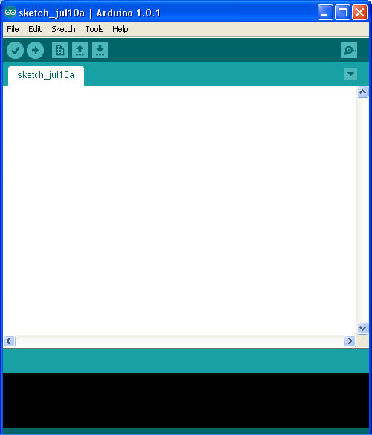
Running the Arduino Development Environment
Now let’s try it out!
Navigate to your Arduino folder
Run the Arduino application
A text box window opens
You write sketches in the text box
Write your program here

Slide 32
Running the Arduino Development Environment
Go to http://arduino.cc/en/Guide/Environment to read a description of the controls in the Development Environment
As you MouseOver each control, it is identified on the Development Environment panel
Check your Device Manager to determine the Arduino com: port. Ensure that your software finds the Arduino board on the right serial com: port by selecting the appropriate one from the Tools|Serial Port menu item

Slide 33
Arduino Programming
The standard Development Environment uses the C programming language. If you are not familiar with C, you can find many tutorials online with a Google search or you may elect to learn as you work your way through the examples provided on the Arduino web site.
A description of the Arduino C language implementation may be found at http://arduino.cc/en/Reference/HomePage

Slide 34
Arduino Programming
Some things to watch for when programming in C
  C is case sensitive so a variable called “Depth” is not the same as one called “depth”
  Lines end with a semicolon
  = assigns a value to a variable while == is a test to determine if two things are equal (don’t mix them up since they behave differently)
  // comments a single line
  /* comments everything following until a */ is reached
  Blocks of program code are enclosed by braces { }

Slide 35
YouTube Arduino Tutorials
Jeremy Blum has an excellent tutorial series on the Artuino on YouTube
Watch the first one now at Jeremy Blum’s Arduino Tutorial 1

Slide 36
Objective 4:
Use sample programs for basic interfacing

Slide 37
Sample Arduino Sketches (BareMinimum)
Go to http://arduino.cc/en/Tutorial/HomePage and examine the “BareMinimum” sketch
Note that every sketch will consist of a Setup function that runs once at the beginning
This is followed by a Loop function that will repeat forever
These functions do not return a value, hence are void
Load the BareMinimum sketch from the examples|01.Basics folder
Upload the sketch to run it (No output expected)

Slide 38
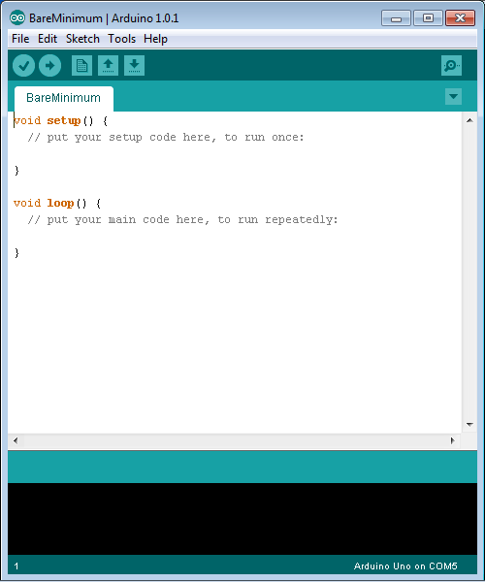

Slide 39
Sample Arduino Sketches (Blink)
Go to http://arduino.cc/en/Tutorial/HomePage, read the background and examine the “Blink” sketch
Load the Blink sketch from the examples|01.Basics folder

Slide 40
/*
Blink
Turns on an LED on for one second, then off for one second, repeatedly.
This example code is in the public domain.
*/
// Pin 13 has an LED connected on most Arduino boards.
// give it a name:
int led = 13;
// the setup routine runs once when you press reset:
void setup() {
// initialize the digital pin as an output.
pinMode(led, OUTPUT);
}
// the loop routine runs over and over again forever:
void loop() {
digitalWrite(led, HIGH); // turn the LED on (HIGH is the voltage level)
delay(1000); // wait for a second
digitalWrite(led, LOW); // turn the LED off by making the voltage LOW
delay(1000); // wait for a second
}

Slide 41
Sample Arduino Sketches (Blink)
Upload the sketch to run it
Observe that the LED is on for 1 second then off for 1 second
This is a digital output since the value is only high or low. There is no intermediate voltage.

Slide 42
Test Your Knowledge (Blink)
Change your sketch to make the LED stay on for 5 seconds then go off for 5 seconds
Upload your revised program to the Arduino
Use a voltmeter to measure between the output pin (13) and GND. You should see the DC voltage vary between 0 and 5V
Change your sketch to make the LED turn on for 50ms and then off for 50ms
Observe the LED blinking faster
Now what is the output voltage reading? Why?
Is this still a digital output?

Slide 43
Test Your Knowledge (Blink) (cont’d)
The voltmeter averages its reading over a longer time than the blink rate so you should read about 2.5V since the LED is on for half of the time. It is still a digital output, as could be shown on an oscilloscope.
Change your sketch so that the LED is on for 25ms and off for 75 ms.
Is the output voltage now about 1.25V?
What voltage would you expect if the LED was on for 75ms and off for 25ms?
Prove it.

Slide 44
Test Your Knowledge (Blink) (cont’d)
Change your sketch so that the LED is on for 5ms and off for 5ms
What output voltage do you expect?
Is it 2.5V?
Why isn’t the LED blinking?
Your eyes cannot perceive flashing faster than about 25 times per second and the LED is flashing at 100 times per second. Research “persistence of vision” if interested in this effect. (think of movies, television, and flip books)

Slide 45
Test Your Knowledge (Blink) (cont’d)
Adjust your sketch for the following ON/OFF times. Record the voltage and observe the LED for each:
  1ms/9ms
  3ms/7ms
  5ms/5ms
  7ms/3ms
  9ms/1ms
Do the voltages match expectations?
How does your eye perceive the LED intensity for each combination?
Reflect on this when PWM is presented later

Slide 46
Sample Arduino Sketches (DigitalReadSerial)
Go to http://arduino.cc/en/Tutorial/HomePage, read the background and examine the “DigitalReadSerial” sketch
Set up the switch input with a pulldown resistor on pin 2 as illustrated
Load the DigitalReadSerial sketch from the examples|01.Basics folder

Slide 47
/*
DigitalReadSerial
Reads a digital input on pin 2, prints the result to the serial monitor
This example code is in the public domain.
*/
// digital pin 2 has a pushbutton attached to it. Give it a name:
int pushButton = 2;
// the setup routine runs once when you press reset:
void setup() {
// initialize serial communication at 9600 bits per second:
Serial.begin(9600);
// make the pushbutton's pin an input:
pinMode(pushButton, INPUT);
}
// the loop routine runs over and over again forever:
void loop() {
// read the input pin:
int buttonState = digitalRead(pushButton);
// print out the state of the button:
Serial.println(buttonState);
delay(1); // delay in between reads for stability
}

Slide 48
Sample Arduino Sketches (DigitalReadSerial)
Run the sketch (don’t forget to enable the serial monitor in the development environment)
What do you observe as you turn the switch on and off?

Slide 49
Test Your Knowledge (DigitalReadSerial)
Modify your sketch so that the pin 13 LED turns on when the switch is closed and off when the switch is open
Test it
Modify your sketch so that the pin 13 LED turns off when the switch is closed and on when the switch is open
Test it

Slide 50
Further Reinforcement
Watch Jeremy Blum’s tutorial 2 at Jeremy Blum’s Arduino Tutorial 2
Note the discussion on switch debounce
If you need a refresher on basic Electrical Engineering, watch tutorial 3 at Jeremy Blum’s Arduino Tutorial 3

Slide 51
Sample Arduino Sketches (AnalogReadSerial)
Go to http://arduino.cc/en/Tutorial/HomePage, read the background and examine the “AnalogReadSerial” sketch
Set up a potentiometer (minimum 500 ohm) between 5V and GND with the wiper connected to analog pin 0
Load the AnalogReadSerial sketch from the examples|01.Basics folder

Slide 52
/*
AnalogReadSerial
Reads an analog input on pin 0, prints the result to the serial monitor.
Attach the center pin of a potentiometer to pin A0, and the outside pins to +5V and ground.
This example code is in the public domain.
*/
// the setup routine runs once when you press reset:
void setup() {
// initialize serial communication at 9600 bits per second:
Serial.begin(9600);
}
// the loop routine runs over and over again forever:
void loop() {
// read the input on analog pin 0:
int sensorValue = analogRead(A0);
// print out the value you read:
Serial.println(sensorValue);
delay(1); // delay in between reads for stability
}

Slide 53
Sample Arduino Sketches (AnalogReadSerial)
Run the sketch (don’t forget to enable the serial monitor in the development environment)
Note that the Arduino reads an analog (continuously variable) value between 0 and 5 volts and represents it as a number between 0 and 1023. 0V is read as 0 and 5V is read as 1023 with all other values scaled to integers between 0 and 1023

Slide 54
Test Your Knowledge (AnalogReadSerial)
How would you display voltage, rather than a value from 0-1023?
We just need to scale the output so that 0 is displayed as 0 and 1023 is displayed as 5
Try changing the println function to:
  Serial.println(sensorValue*5/1023);
Upload it.
What is displayed?
Is it satisfactory?
Did you expect better resolution?

Slide 55
Test Your Knowledge (AnalogReadSerial)
The problem is that the C language is treating the values as integers. Instead, we would like to have floating point values.
Try replacing the println function with:
  Serial.println(sensorValue*5.0/1023.0);
Run it.
Is it satisfactory?
Note that 5.0 is treated as a floating point value while 5 is treated as an integer. C gives the user a lot of power but “with great power…”

Slide 56
Test Your Knowledge (AnalogReadSerial)
A potentiometer can be used as a position sensor (rotary or linear). Joysticks use rotary potentiometers
Try substituting the potentiometer with two resistors in series between 5V and GND (the values aren’t critical but keep them over 100 ohms and less than 10k)
Connect analog pin 0 to the junction between the two resistors
Is the voltage reading on analog pin 0 what you would expect it to be based on Ohm’s Law?

Slide 57
Test Your Knowledge (AnalogReadSerial)
Instead of two resistors, try with one resistor and a sensor that changes resistance. Some examples include:
  Cadmium Sulfide (CdS) light sensor,
  Thermistor
  Force sensor
You may need to adjust the resistor value depending on your device but start with one between 1k and 10k
Now when you run your AnalogReadSerial sketch, you should see the voltage vary as you change the sensed parameter

Slide 58
Test Your Knowledge (AnalogReadSerial) (optional)
If you have a CdS light sensor:
  Remove the CdS sensor from the circuit and use an ohmmeter to measure the sensor’s resistance in the dark
  Now measure the sensor’s resistance in the light
  Using a spreadsheet, fill column A with resistance values from 100 to 10000 in steps of 100. This will represent the resistance placed in series with the CdS sensor
  Using your knowledge of Ohm’s Law, use a formula to fill column B with the voltage that would be read if the CdS sensor was in the dark for each resistor value in column A
  Fill column C with the voltage that would be read if the CdS sensor was in the light for each resistor value in column A

Slide 59
Test Your Knowledge (AnalogReadSerial) (optional)
  Fill column D with the difference between the dark and light columns for each resistor value in column A
  Make a graph of light level range (column D) against resistor value (column A)
  What would be the optimum choice of resistor value to couple with your CdS sensor, that is, which resistor gives the largest range?
  Replace the 1k resistor in your circuit with a near-optimum resistor value and record the difference in voltage range between light and dark compared to the range with the 1k resistor

Slide 60
Further Reinforcement
Watch Jeremy Blum’s tutorial 4 at Jeremy Blum’s Arduino Tutorial 4

Slide 61
Challenge
A thermistor changes resistance with temperature changes
Propose a procedure for determining an optimal resistance to put in series with a thermistor for a range of water temperatures between 5°C and 40°C based upon the procedure described for a light sensor above
Note that for this exercise, putting the thermistor in a watertight plastic bag will keep it dry as long as the bag opening is held above water

Slide 62
Challenge (cont’d)
Get a thermistor and prove your procedure
Plot a calibration graph for your thermistor-resistor combination against a known thermometer standard between 5°C and 40°C
Using your thermistor, test the room temperature.
Does your value match the standard thermometer?
Would your thermistor have a better temperature discrimination at the low end or high end of the temperature range?

Slide 63
Challenge (cont’d)
Propose a procedure for determining how fast your thermistor responds to temperature changes
Try it
Attach your thermistor to a small block of plastic (about 1g) using electric tape
How is the response time affected?
Think of two reasons why this might be.

Slide 64
Reflection
Think of other sensors that might be used on an ROV
Are the sensors used for digital or analog measurement?
How would you configure a pin that is going to control thruster speed?
How often would you need to read a joystick’s position in order to control an ROV? Every 1mS? Every 10mS?, Every 100mS? Every 1S? What factors affect your choice?

